Slide 1

Object Oriented Design and Programming
Week 8
Version 2 – 18th December 2015

Slide 2
Objectives
ArrayList
Various Operations on ArrayList
Iterators
Introduction to classes and objects

Slide 3
ArrayList
Standard Java arrays are of a fixed length.
After arrays are created, they cannot grow or shrink, which means that you must know in advance how many elements an array will hold.
Array lists are resizable array and can be created with an initial size.
When this size is exceeded, the collection is automatically enlarged. When objects are removed, the array may be shrunk.
It is found in java.util package

Slide 4
ArrayList Creation
Creating an arrayList:
ArrayList<Type> arrayList= new ArrayList<>();
ArrayList<Type> arrayList= new ArrayList<>(15);
<Type> represents the type of elements of arrayList. For example:
ArrayList <Integer> list= new ArrayList<>();
ArrayList <String> list= new ArrayList<>();
Note:- You need to import java.util.ArrayList under package declaration

Slide 5
ArrayList Important Information
Did you notice <Integer>, why didn’t we use int as we used in normal arrays?
Answer is:
Integer is wrapper class of integer data type.
We need to use wrapper class of each data type instead of primitive data type while creating ArrayList.
So, find wrapper class of each primitive data type and then create ArrayList.

Slide 6
Operations on ArrayList
Open https://docs.oracle.com/javase/7/docs/api/ to have a look at various methods of ArrayList Class.
Some common operations are:
Adding an item into ArrayList - Checking if list is empty
Accessing an item - Checking for an element
Change the item - Checking the index of an element
Remove the item
Size of ArrayList
Looping through ArrayList

Slide 7
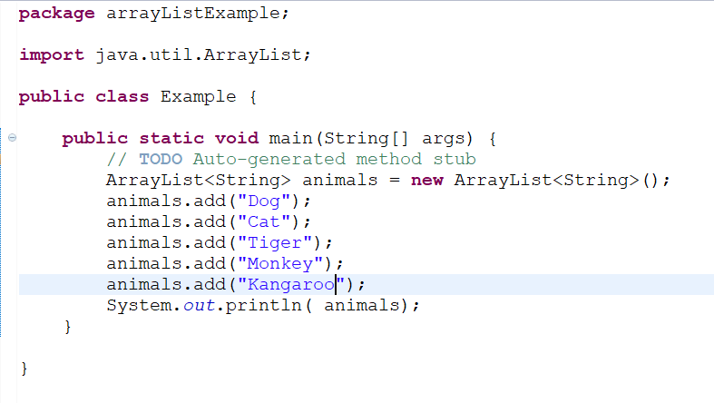
Adding an item into the ArrayList
add() method is used to add the elements into the ArrayList
Output is:-

Slide 8
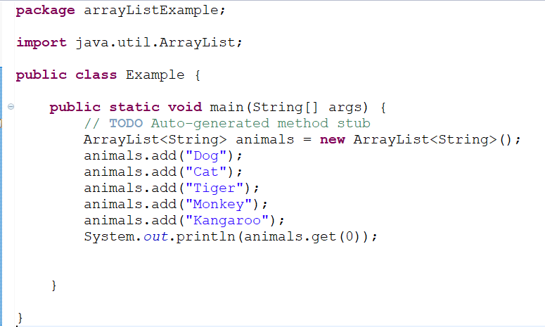
Accessing an item
get() method is used to access an item from ArrayList.
Note:- ArrayList index also starts from 0 like arrays
Output is:- Dog

Slide 9
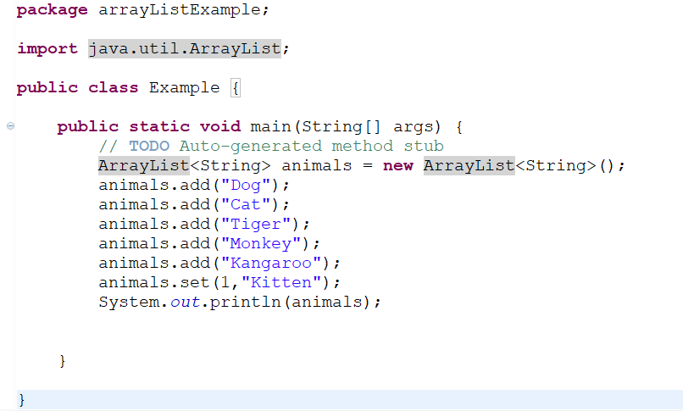
Change the item
set() method is used to change the element
Output is:-

Slide 10
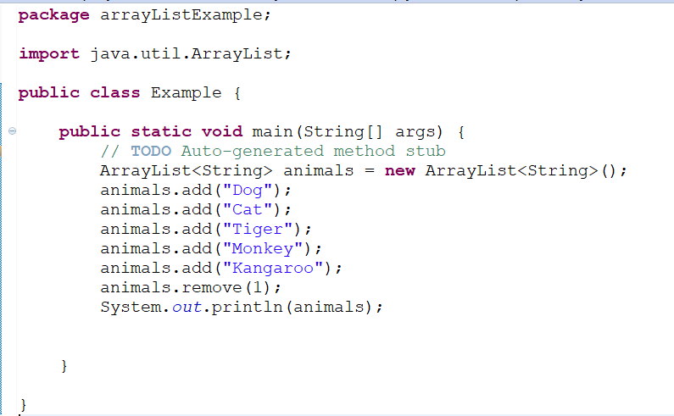
Remove the item
remove() method is used to remove the elements from ArrayList
Output is:- [Dog, Tiger, Monkey, Kangaroo]

Slide 11
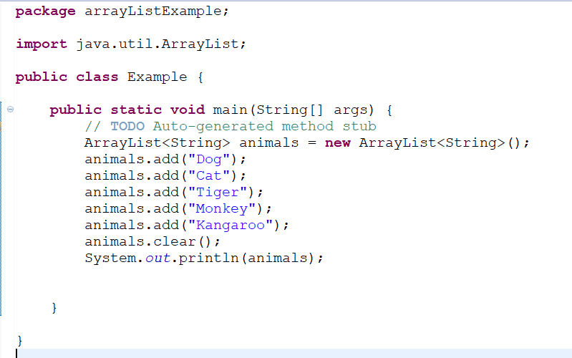
Removing all elements
clear() method is used to clear all elements.
Output is:- []

Slide 12
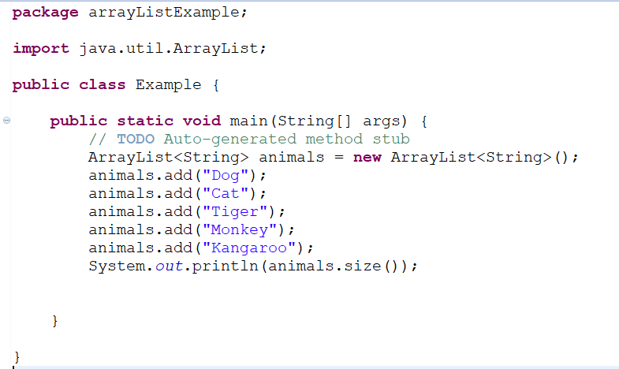
Size of ArrayList
size() method is used to find the number of elements in ArrayList
Output is:- 5

Slide 13
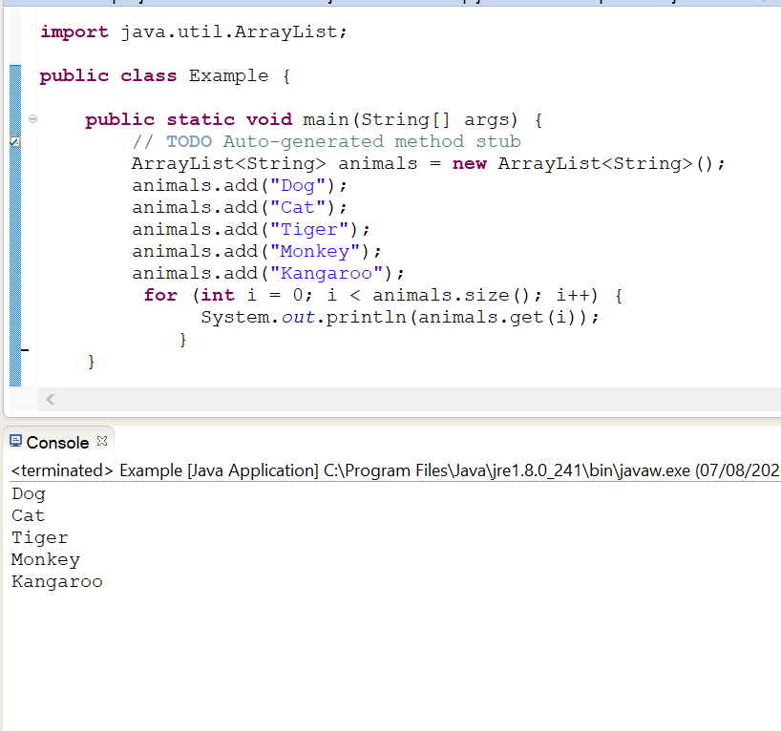
Looping through an ArrayList
Any loop can be used and size() method is used to get number of elements

Slide 14
Looping with an Iterator
An iterator is an object that can be used to iterate through ArrayList.
To use an iterator, it should be imported from java.util package.
Iterator<Type> it = arraylist.iterator();
<Type> refers to type of elements of ArrayList and arraylist is name of ArrayList

Slide 15
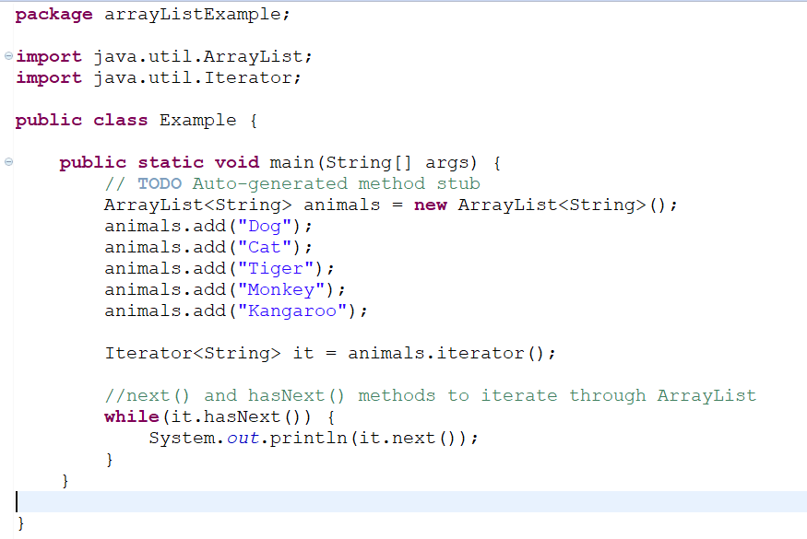
Looping with an Iterator

Slide 16
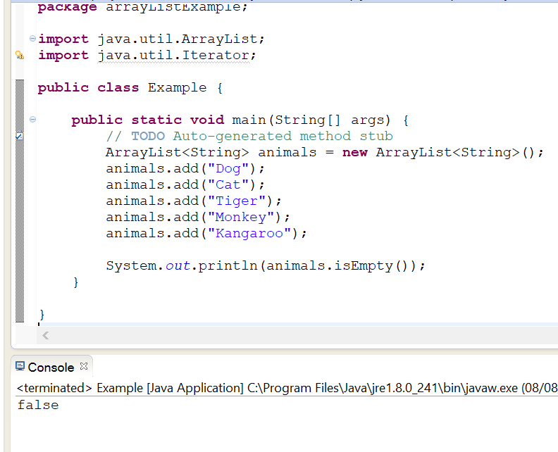
Checking if list is empty
isEmpty() method is used to check if an ArrayList is empty or not. It returns true or false.

Slide 17
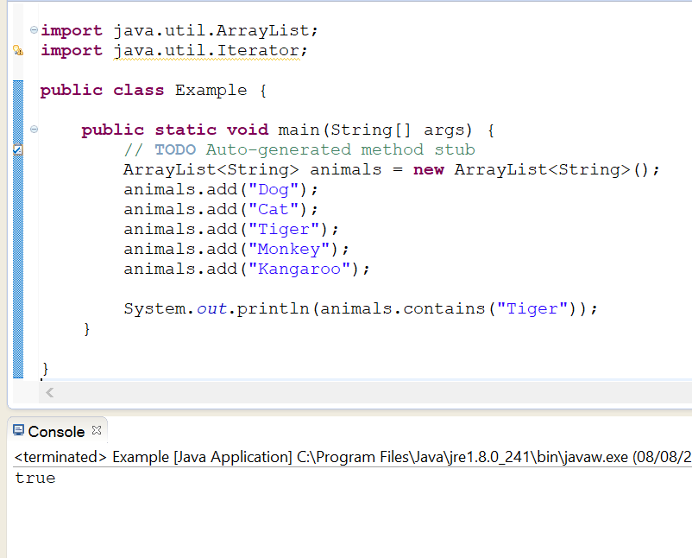
Checking for an element in ArrayList
contains() method is used to check if an element exists in arrayList or not. It will return true if element exists and false if not.

Slide 18
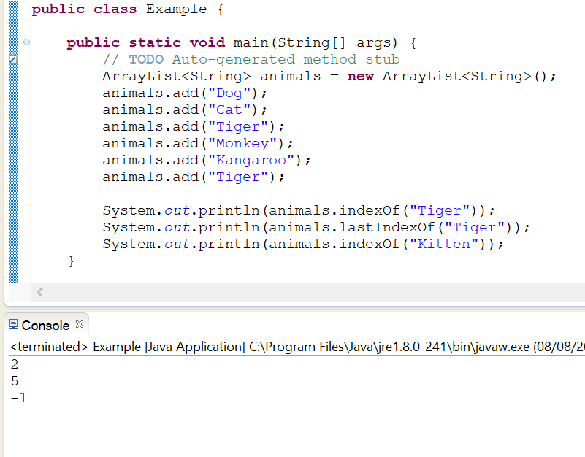
Finding index of an element
index() and lastIndex() is used to find the index of first and last occurrence respectively.
It will return -1 if element not found in arrayList.

Slide 19
Programming Logic and Design Ninth Edition
Principles of Object Oriented Design and programming 1- definition and creation of classes and objects, constructors and destructors

Slide 20
Object Oriented Programming
Object-oriented programming (OOP) is a style of programming which
Focuses on an application’s data and the methods you need to manipulate that data.
Object-oriented programming adds several new concepts to programming and involves a different way of thinking.

Slide 21
Objects
Objects both in the real world and in object-oriented programming are made up of attributes and methods.
Attributes are the characteristics that define an object.
For example, some of your automobile’s attributes are its make, model, year and purchase price.
Other attributes include whether the automobile is currently running, its gear, its speed and whether it is dirty.
All automobiles possess the same attributes, but not, of course, the same values for those attributes

Slide 22
Classes
A group or collection of objects with common properties.
An instance of a class is an existing object of a class.
Therefore, your black Range Rover Automobile with the dent can be considered an instance of the class that is made up of all automobiles.
So, a class is a category of things; an object is a specific instance of a class.

Slide 23
Classes and Objects
A class definition is a set of program statements that tell you
Characteristics of the class’s objects
The methods that can be applied to its objects.

Slide 24
Classes and Objects
Another example
Dish is a class.
When you know an object is a Dish, you know it can be held in your hand and you can eat from it.
The specific object myBlueDinnerPlateWithTheChipOnTheEdge is an instance of the Dish class
So is auntJanesAntiquePunchBowl and myCatsFoodBowl

Slide 25
Classes and Objects
A class can contain three parts:
Every class has a name.
Most classes contain data, although this is not required.
Most classes contain methods, although this is not required.
Programmers often use a class diagram to illustrate class features.
A class diagram consists of a rectangle divided into three sections

Slide 26
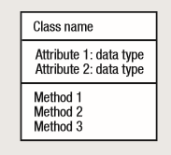
Class Diagram
A class diagram consists of a rectangle divided into three sections.
The top section contains the name of the class
The middle section contains the names and data types of the attributes
The bottom section contains the methods

Slide 27
Activity
Think about an Employee
What are features that an employee class can have?
What are the functions that can be done with this class?

Slide 28
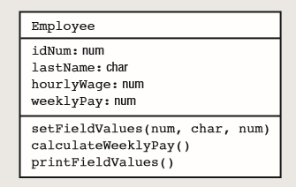
Employee Class Diagram without access specifiers

Slide 29
Access Specifiers
Let’s think about one scenario:
If your computer has a warranty and something goes wrong with its operation.
You cannot open the CPU yourself, remove and replace parts, and then expect to get your money back for a device that does not work properly.
Instead, when something goes wrong with your computer, you must take the device to the manufacturer.
The manufacturer guarantees that your machine will work properly only if the manufacturer can control how the internal mechanisms of the machine are modified.

Slide 30
Access Specifiers
Like last scenario:
You might design a class that performs a complicated statistical analysis on some data and stores the result.
You would not want others to be able to alter your carefully crafted product.
You can keep it private by using access specifiers.
An access specifier (or access modifier) is an adjective that defines the type of access outside classes will have to the attribute or method

Slide 31
Access Specifiers
There are four types of access specifiers in java
Private: The access level of a private modifier is only within the class. It cannot be accessed from outside the class.
Public: The access level of a public modifier is everywhere. It can be accessed from within the class, outside the class, within the package and outside the package.
Default: The access level of a default modifier is only within the package. It cannot be accessed from outside the package. If you do not specify any access level, it will be the default.
Protected: The access level of a protected modifier is within the package and outside the package through child class. If you do not make the child class, it cannot be accessed from outside the package.

Slide 32
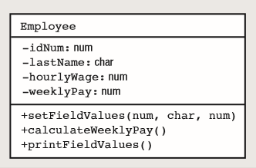
Class Diagram with Access Specifier
Use symbols as follows:
Public +
Private –
Protected #
Default ~
Classes can contain public data and private methods, but it is common for most data to be private and most methods to be public.

Slide 33
Static and Instance variables
The second section of class diagram represents data or features or variables of class.
These variables can be static or instance variables.
Watch this video to understand the static and instance variables:
https://www.youtube.com/watch?v=jYNUsgHV_EU

Slide 34
Methods
Third section of class diagram has methods which can
Constructor
Getters
Setters
Other methods to perform specific tasks related to class

Slide 35
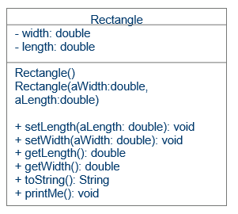
Complete class diagram
Class name
List of variables
Constructor
Setters
Getters
Other methods

Slide 36

kent.edu.au Kent Institute Australia Pty. Ltd. ABN 49 003 577 302 ● CRICOS Code: 00161E ● RTO Code: 90458 ● TEQSA Provider Number: PRV12051

